Slide 1
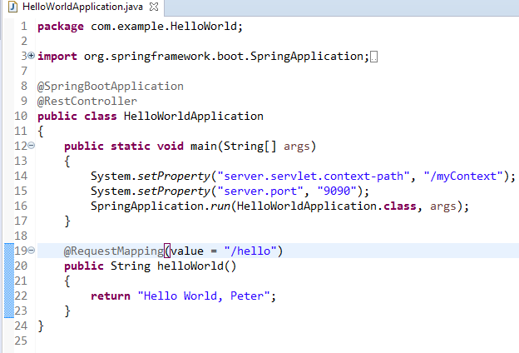
Spring Boot – How to Change Default Context Path and port using Java System Property?
We can also set the context path and port number as a Java system property before even the context is initialized

